Slide 1
Intelligent Voice Desktop Assistant

Slide 2
Voice assistants are AI-powered virtual assistants that respond to voice commands and perform various tasks.

Slide 3
Voice and typed Controlled Features
Greeting
Search Wikipedia
Open websites
Play music
Tell time

Slide 4
Voice and typed Controlled Features
Open apps
Send mails
Tell weather
Tell jokes
Stop execution command

Slide 5
Base ideas
Youtube video https://www.youtube.com/watch?v=s_8b5iq4Rvk&t=856s
Searching on internet

Slide 6
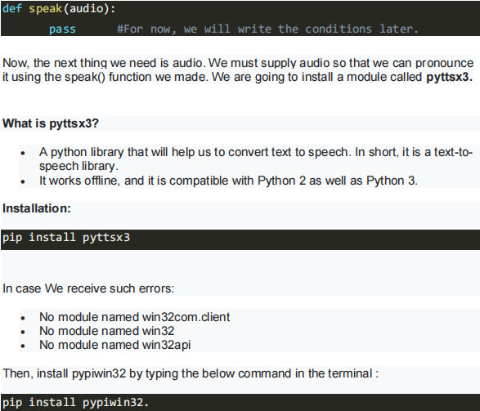
Errors we faced
Module not found
Path location error
Speech recognition error
Infinite Loop without Break Condition:
Microphone connection issues

Slide 7
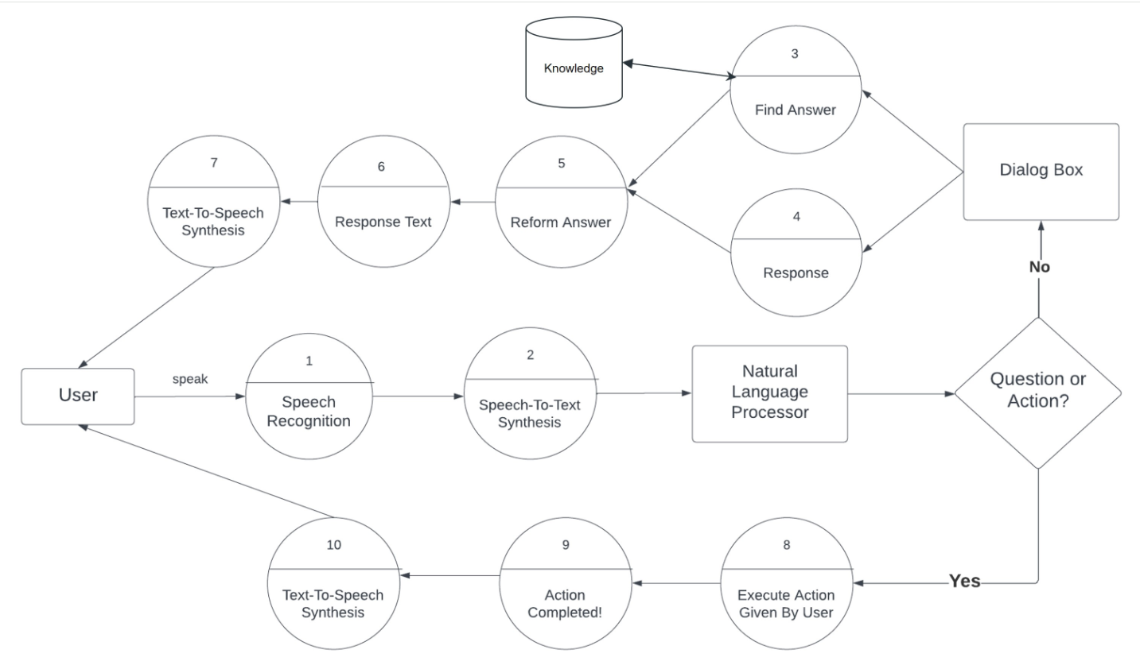
How it works

Slide 8
Benefits of Voice Assistants
Convenience:
Hands-free operation
Accessibility for users with disabilities
Efficiency
Faster task completion
Reduction in manual input
Personalization:
Learning and adapting to user behavior

Slide 9
Github
https://github.com/imusman-8/AI-voice-assistant

